Slide 1
Venera

Slide 2
Content:
Participant
Application we have used
Home page
Explanation for the site
Event page
Location and Contacts
Statistics
How to deal with disasters
Logo

Slide 3
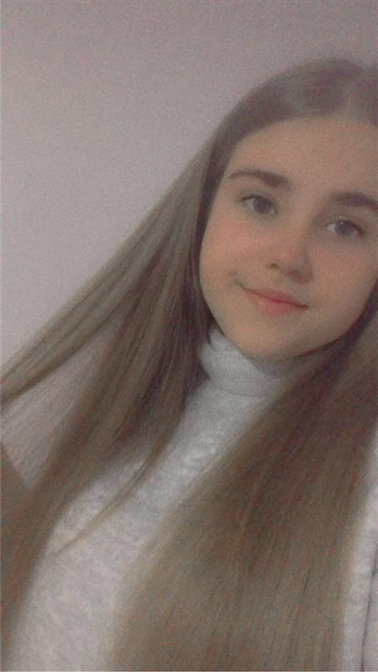
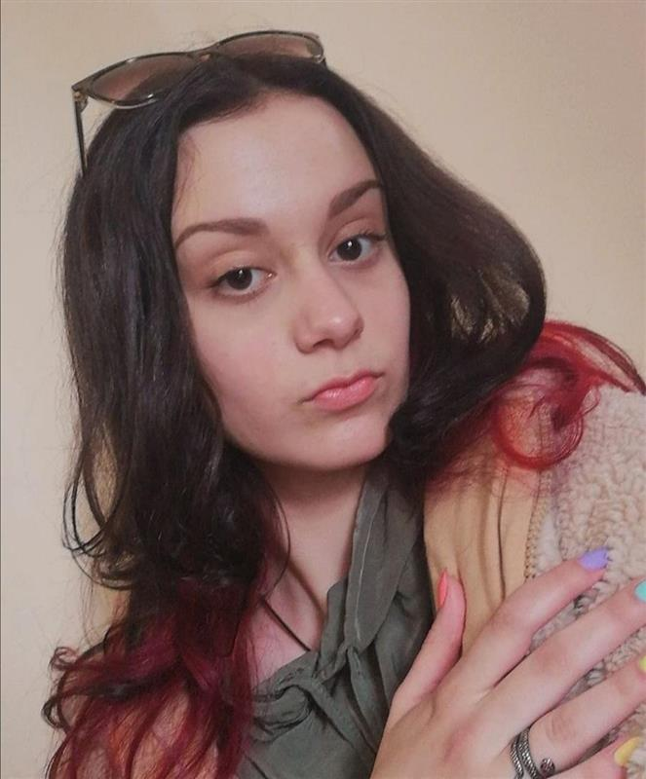
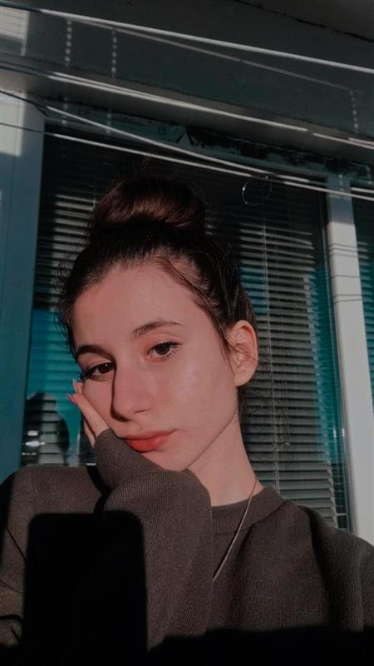
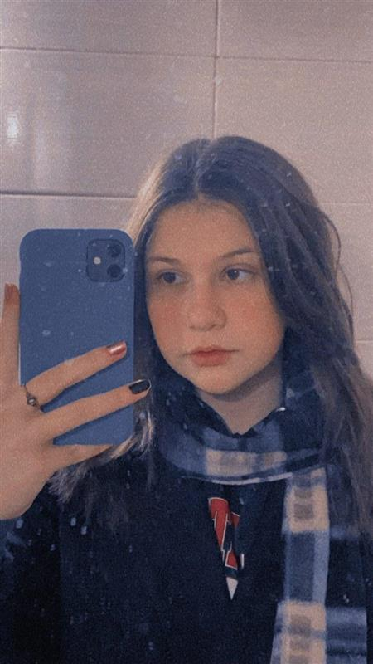
Participants
Kameliya Yaneva 9g class
Scrum trainer
Petya Petkova
9v class
Back-End Developer
Vesela Dekova
9a class
Designer
Polina Petrova
9b class
Front-End Developer

Slide 4






Application we have used

Slide 5
Home page
Home page;
Menu;
About us;

Slide 6
Explanation for the site
Fire crews;
Fire trucks;
Fire extinguishers;

Slide 7
Event page
Contact email;
Contact phone;
Form (day, time of the accident, address);

Slide 8
Location and Contacts
Location map;
Contact us;

Slide 9
Statistics
Seasons during which a fire is most likely to occur;
Large cities where fire is most likely to occur;
Table Burgas region (fires);
Legend with colors of statistics;

Slide 10
How to deal with disasters
Earthquakes;
Fires;
Floods;
Disasters;

Slide 11
Logo
Static;

Slide 12
Thank you for your attention!

